Slide 1
CreditWatch:
Predicting Credit Default
Team Members: Aarthi Padmanabhan, Madhurya Shankar, Sandhya Kilari

Slide 2
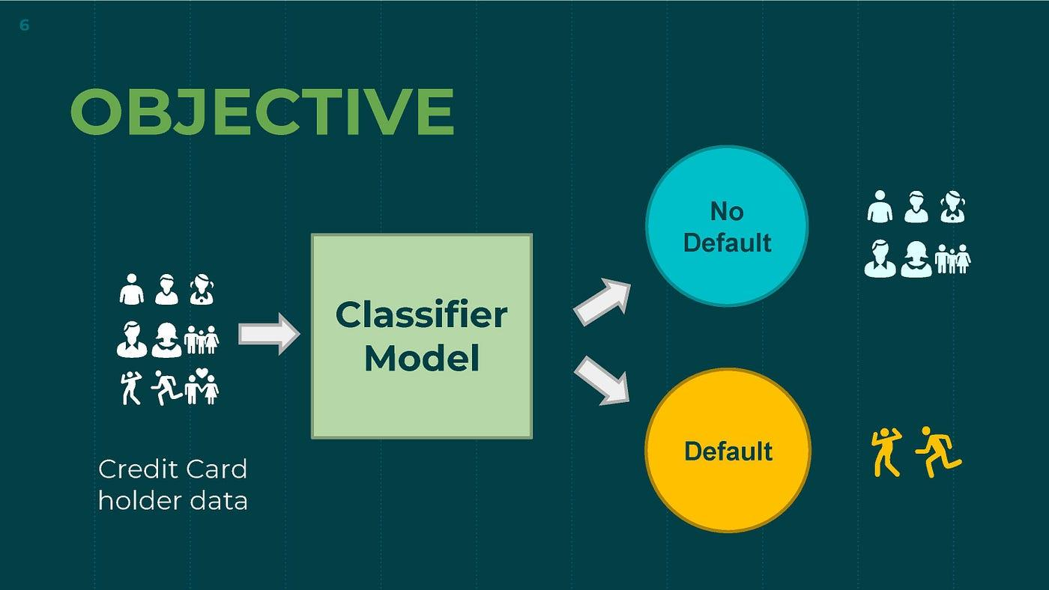
Introduction
Credit default occurs when a borrower fails to meet the required debt payments on a loan or credit agreement
Long-term: Impact on credit score, potential legal actions, and restricted access to future credit
Risk reduction: Enhances decision-making processes by forecasting potential defaults

Slide 3
Data Description
Scope of the Dataset
Comprehensive data comprising 30,000 customer records.
Aimed at predicting default payments among credit card users in Taiwan, from April 2005 to September 2005.
Key features
Identity and Credit Info: Includes customer ID, credit limits, and demographics such as gender, education, marital status, and age.
Payment History: Tracks monthly payment status and bill amounts for the past six months.
Payment Outcomes: Documents payment amounts and flags potential defaults in the following month.
One predictive binary label (Default: Yes = 1, No = 0)
No missing values in the dataset
Dataset: https://www.kaggle.com/datasets/uciml/default-of-credit-card-clients-dataset/data

Slide 4
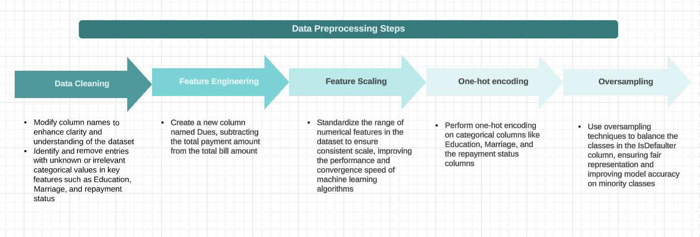
Data Preprocessing

Slide 5
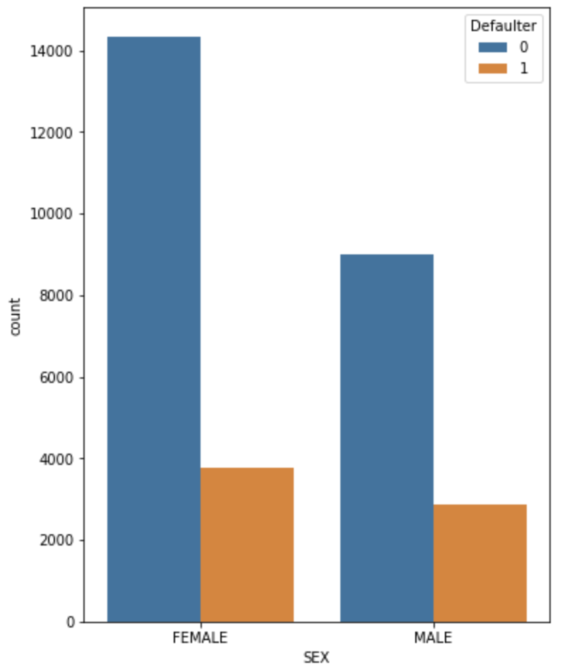
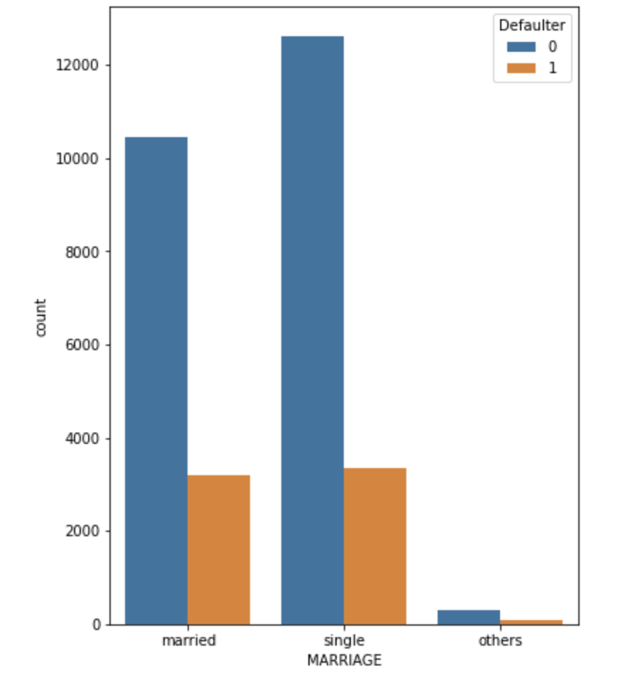
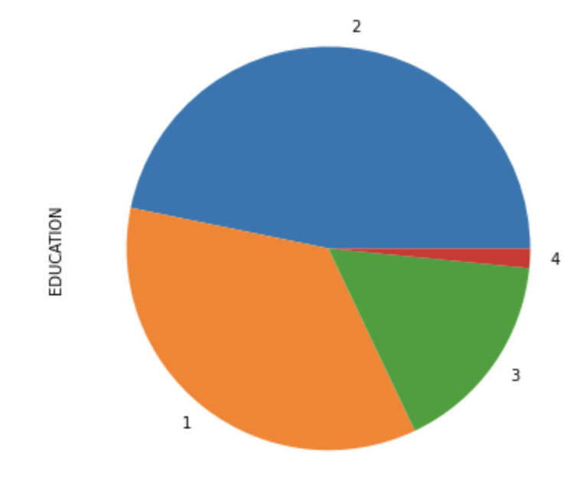
Exploration of univariate variables
Analysis on categorical variables:
Dataset contains a higher number of female customers.
Customers having university education are relatively higher followed by graduates.
There are more single customers as compared to married.
Relatively higher number of customers have duly paid bill amount each month.
Approximately 30% customers are defaulters.

Slide 6
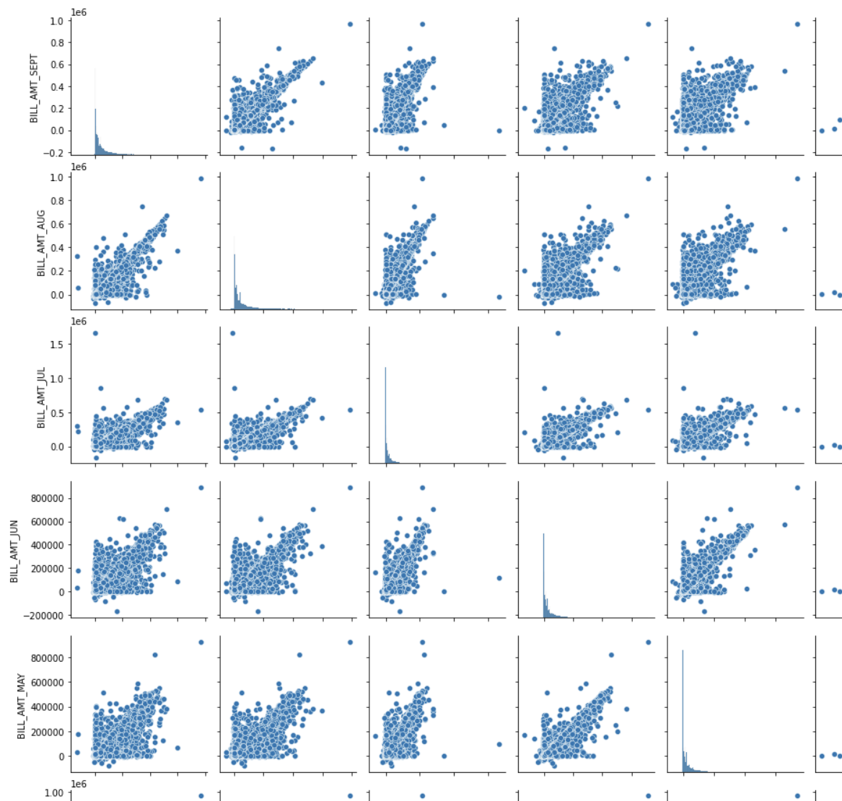
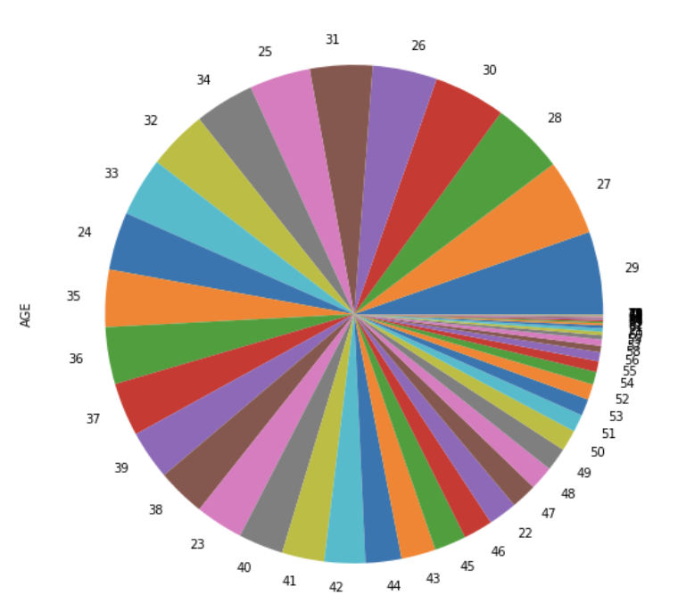
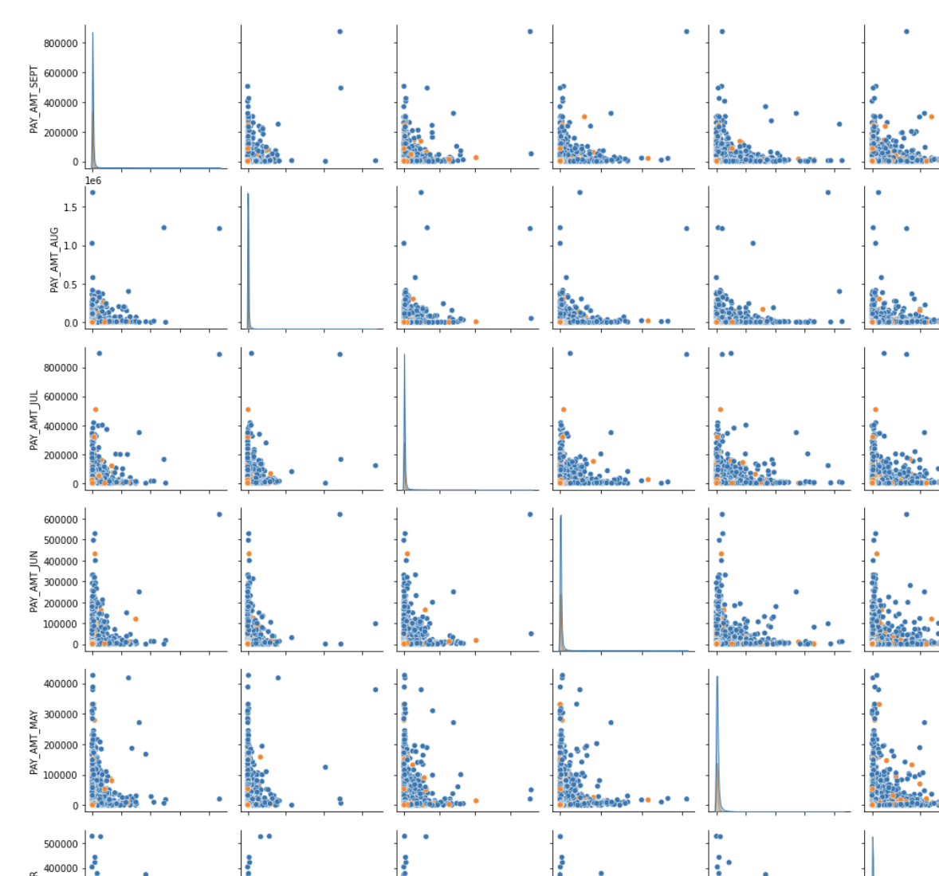
Analysis on continuous variables:
Most customers are aged between 25 to 45.
Balance limits mostly range from 50,000 to 250,000.
Bill amounts usually span from -9,500 to 260,000, predominantly clustering between 1,000 to 55,000.
Payments over the last six months typically range from 0 to 70,000, with most under 10,000.

Slide 7
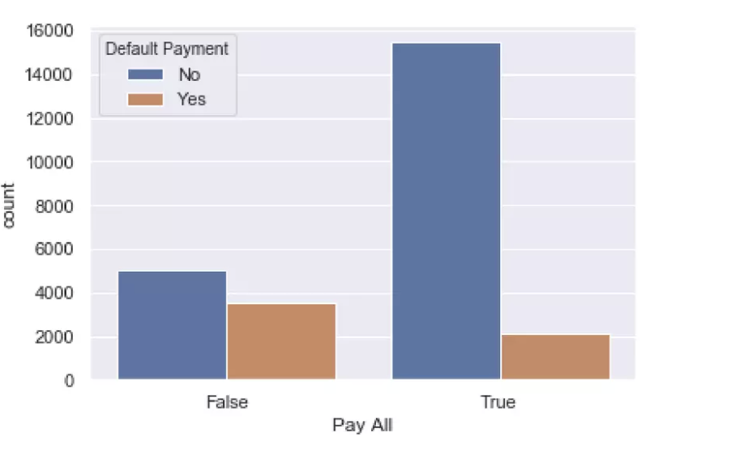
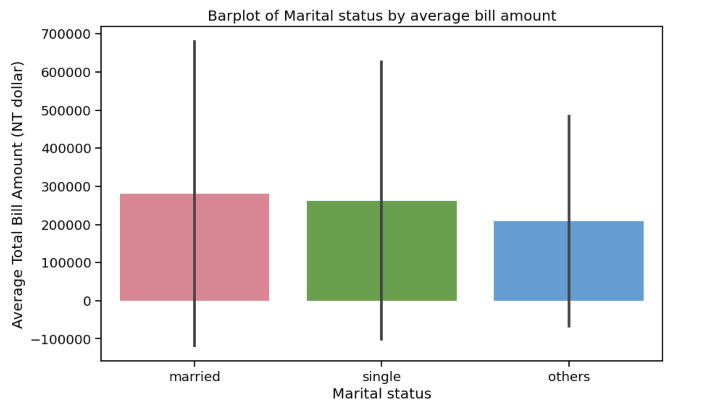
Exploration of pair of variables
Does having a delay in previous payment Do married people spend more
impact chances of default? than others?

Slide 8
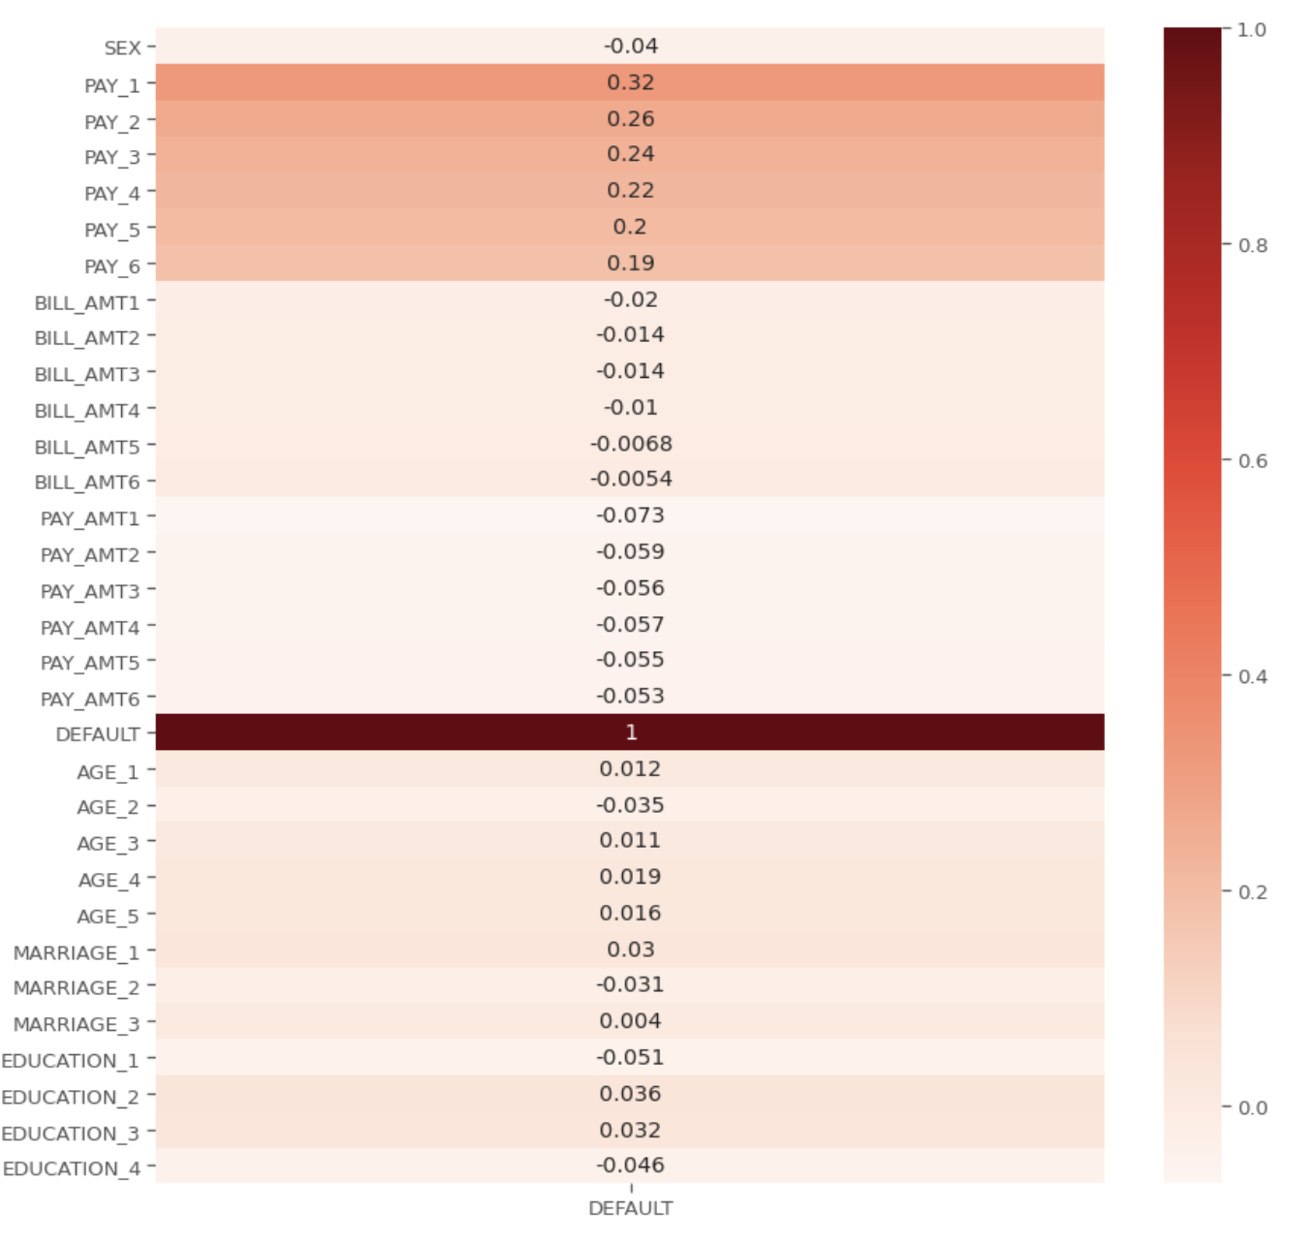
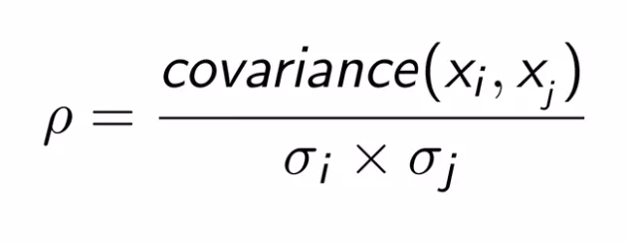
Pearson’s Correlation
Repayment status of customers (PAY_1 - PAY_6) have the higher correlation towards the label.

Slide 9
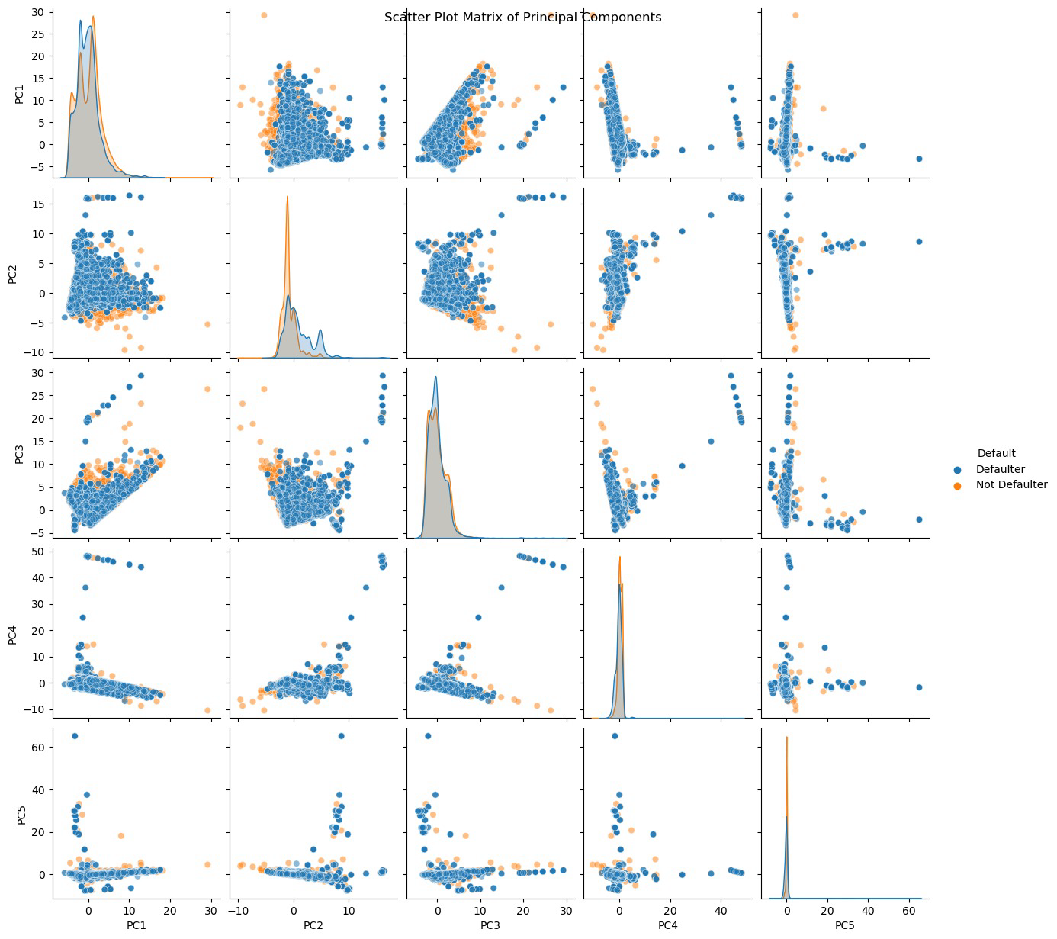
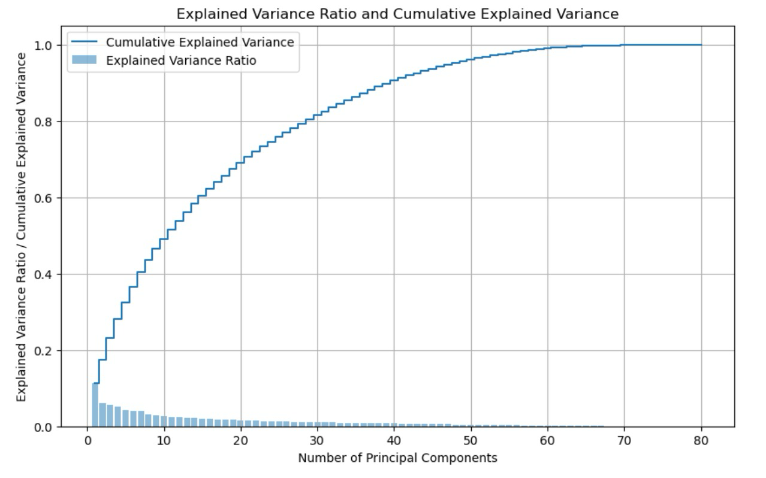
Feature Selection/Dimensionality Reduction

Slide 10
Modeling Approaches Used
Linear Models
Logistic Regression
Gaussian Naive Bayes
Non-linear Models
Random Forest
XGBoost
Non-Linear Support Vector Machine
Multilayer Perceptron (MLP) Neural Network

Slide 11
Exploring Classification Model Evaluation
Models | Accuracy | Precision | Recall | F1-Score | Confusion Matrix
Logistic Regression | 0.7115 | 0.7846 | 0.5832 | 0.669 | [[3805 725] [1888 2642]]
Gaussian Naive Bayes | 0.55 | 0.884 | 0.11 | 0.2 | [[4461 69] [4002 528]]
Random Forest | 0.93 | 0.91 | 0.966 | 0.93 | [[4108 422] [ 154 4376]]
XGBoost | 0.8025 | 0.8028 | 0.801 | 0.8024 | [[3638 892] [ 897 3633]]
Non-Linear Support Vector Machine | 0.714 | 0.777 | 0.6002 | 0.677 | [[3750 780] [1811 2719]]
Multilayer Perceptron (MLP) Neural Network | 0.71 | 0.79 | 0.56 | 0.66 | [[3881 649] [1957 2573]]

Slide 12
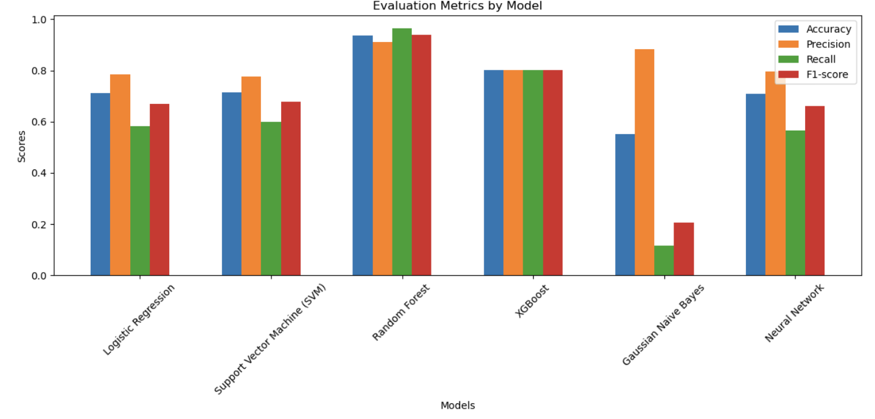
Comparison of Evaluation Metrics

Slide 13
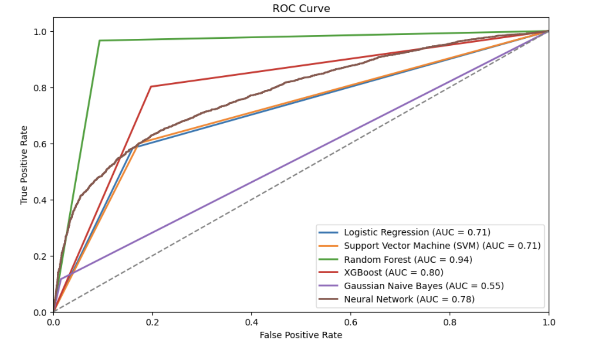
ROC Curve of Implemented Algorithms
Random Forest outperforms with the highest AUC of 0.94
Gaussian Naive Bayes shows the lowest performance with AUC of 0.55
Logistic Regression and SVM have equal AUCs of 0.71, indicating similar performance

Slide 14
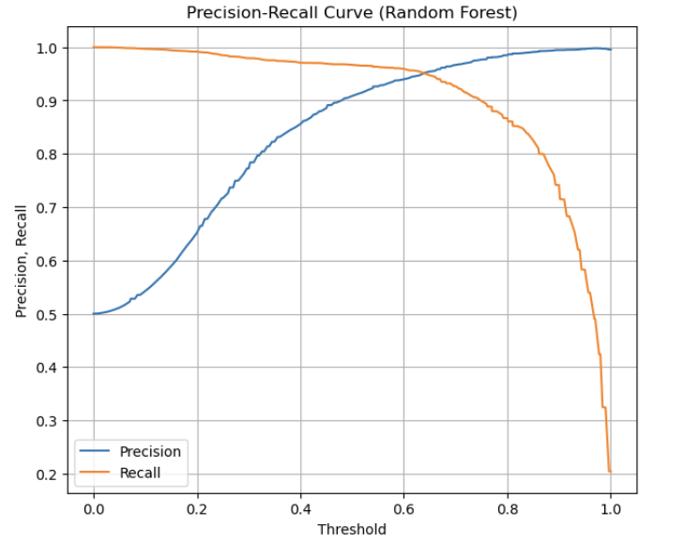
Precision-Recall Curve - Random Forest
The curve suggests that as the threshold for predicting a credit default increases, precision improves, but recall decreases.

Slide 15
Conclusion & Future Work
The Random Forest algorithm yielded the most accurate predictions for credit default, suggesting it is well-suited for this application
Investigate ensemble methods or advanced neural networks to further improve prediction accuracy
Evaluation of model performance on a larger and more diverse dataset to ensure scalability and robustness
Plan to integrate model predictions into a decision support system for financial institutions

Slide 16
Questions?

